Slide 1
802.11 MEDIUM CONTENTION
Rajasekar S

Slide 2
CONTENTS
CSMA/CA
Distributed Coordination function
EDCA
Interframe Spaces
Random Backoff/Contention Window
TXOP
Frame Transmission

Slide 3
CSMA/CA
Idea: The chance of collision can be reduced if a station senses the medium before trying to use it.
Physical Carrier Sense (Clear Channel Assessment)
ED (Energy Detection)
CS (Carrier Sense)
Virtual Carrier Sense (Network Allocation Vector)
Duration value set in each frame’s MAC header where other stations set their NAV to this if the sense medium is busy.

Slide 4
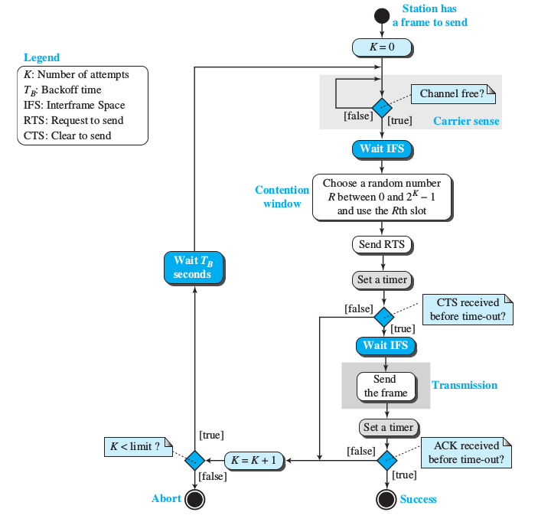
CSMA/CA Flowchart

Slide 5
Distributed Coordination Function
The four main components of DCF:
Carrier sense
Duration/ID field
Interframe space
Random backoff timer

Slide 6
Enhanced Distributed Channel Access
Additional components included as part of EDCA:
AIFS
QoS-Based Random Backoff Timer
TXOP

Slide 7
Interframe Spaces
The IFS is a quiet period that APs and stations must wait before any 802.11 frame transmission.
The purpose of an IFS is both to provide a buffer between frames to avoid interference as well as to add control and to prioritize frame transmissions.
The length of the IFS time is depends on previous frame type, following frame type, access category, coordination function in use & PHY type as well.
Short Interframe Space (SIFS)
It is the shortest IFS, has highest level of priority.
Reduced Interframe Space (RIFS)
RIFS were introduced with 802.11n to improve efficiency for transmissions to the same receiver in which a SIFS-separated response is not required, such as a transmission burst (CFB-Contention Free Burst).

Slide 8
Contd...
DCF Interframe Space (DIFS)
DIFS = SIFS + 2 x SlotTime
Extended Interframe Space (EIFS)
EIFS (in DCF) = SIFS + DIFS + ACK_Tx_Time
EIFS 802.11b/g/n devices using DSSS = 364μS
EIFS 802.11g/n devices using OFDM = 160μS
EIFS 802.11a/n devices (5GHz) = 160μS
EIFS (in EDCA) = SIFS + AIFS[AC] + ACK_Tx_Time
Arbitration Interframe Space (AIFS)
Shall be used by the QoS STA's.
AIFS[AC] = AIFSN[AC] × SlotTime + SIFSTime
PCF Interframe Space (PIFS)
Used by STAs during the contention-free period (CFP) in PCF mode.
PIFS = SIFS + SlotTime

Slide 9
Random backoff
An 802.11 station may contend for the medium during a window of time known as the backoff time.
STA shall use the Random back-off after the defer period to avoid collisions.
Backoff Time = Random() × aSlotTime
Random() = Pseudo-random integer select from interval 0,CW(Contention Window) .
aSlotTime =Slot time sizes are dependent on the physical layer specifi cation (PHY) in use (DSSS, OFDM,etc. ).

Slide 10
Contention Window
To contend for medium access after the IFS, each station selects a backoff value called random backoff period and is selected at random by the STA from a window of possible values called a contention window (CW).
CW = 2^k – 1, aCWmin ≤ CW ≤ aCWmax.
Contention window (CW) parameter shall take an initial value of aCWmin.
The CW shall take the next value in the series every time an unsuccessful attempt to transmit an MPDU .
Once it reaches aCWmax, the CW shall remain at the value of aCWmax until the CW is reset.
In EDCA medium access (QoS stations & AP), each AC has a CW_min & CW_max.

Slide 11
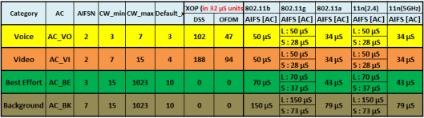
TXOP- Transmit Opportunity
EDCA introduce this TXOP which is a time period where one device, called TXOP holder has unfettered acccess to the channel for data transmission.
802.11e standard defines default TXOP limit value for each AC, but values can be configured on AP

Slide 12
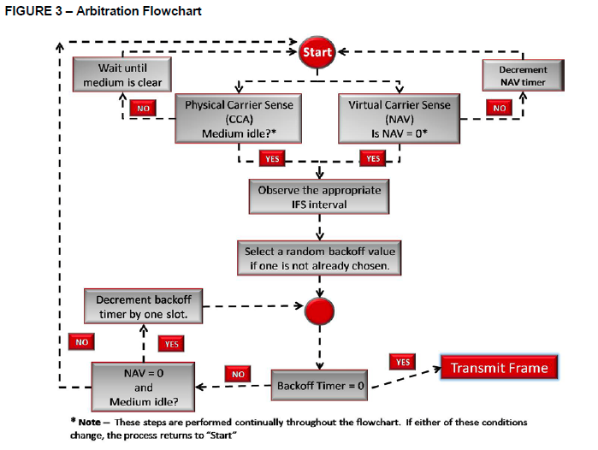
Arbitration Flowchart

Slide 13
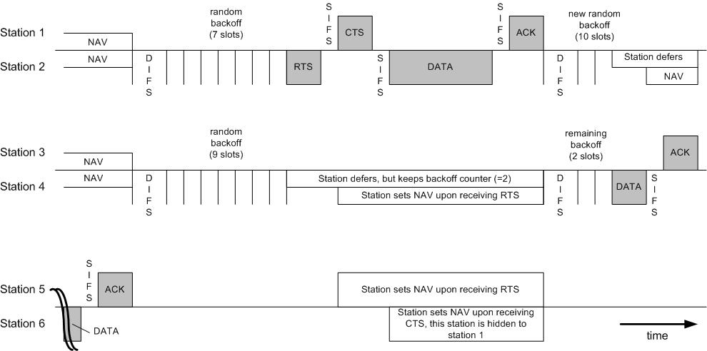
Frame Transmission

